Slide 1
Software Cost Estimation: cont…

Slide 2
COCOMO 81
COCOMO (CONSTRUCTIVE COST MODEL)
  First published by Dr. Barry Boehm, 1981
Basic model:
effort = c x size^{k}
  C and k depend on the type of system: organic, semi-detached, embedded
  Size is measured in ‘kloc’ ie. Thousands of lines of code
Notes:
Recall that the aim of this lecture is to give an overview of principles. COCOMO81 is the original version of the model which has subsequently been developed into COCOMO II some details of which are discussed in Section 5.13. For full details read Barry Boehm et al. Software estimation with COCOMO II Prentice-Hall 2002.

Slide 3
COCOMO Mode & Model
Three development environments (modes)
  Organic Mode
  Semidetached Mode
  Embedded Mode
Three increasingly complex models
  Basic Model
  Intermediate Model
  Detailed Model

Slide 4
COCOMO Modes
Organic Mode
  Developed in familiar, stable environment
  Product similar to previously developed product
  <50,000 DSIs (ex: accounting system)
Semidetached Mode
  somewhere between Organic and Embedded
Embedded Mode
  new product requiring a great deal of innovation
  inflexible constraints and interface requirements
  (ex: real-time systems)

Slide 5
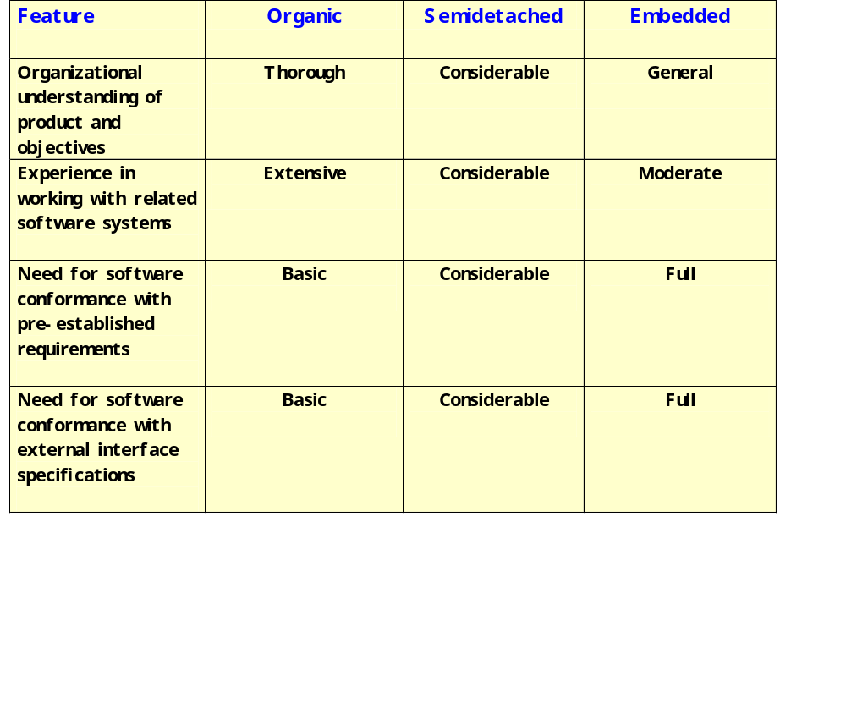
Modes

Slide 6
COCOMO Models
Basic Model
  Used for early rough, estimates of project cost, performance, and schedule
  Accuracy: within a factor of 2 of actuals 60% of time
Intermediate Model
  Uses Effort Adjustment Factor (EAF) fm 15 cost drivers
  Doesn’t account for 10 - 20 % of cost (trng, maint, Qual, etc)
  Accuracy: within 20% of actuals 68% of time
Detailed Model
  Uses different Effort Multipliers for each phase of project (Most project managers use intermediate model)

Slide 7
Basic Effort Equation (COCOMO 81)
Effort=A(size)^{k}
  A is a constant based on the developmental mode
    organic = 2.4
    semi = 3.0
    embedded = 3.6
  Size = 1000s Source Lines of Code (KSLOC)
  k is constant for a given mode
    organic = 1.05
    semi = 1.12
    embedded = 1.20

Slide 8
The COCOMO Constants
System type | A | k
Organic (broadly, information systems) | 2.4 | 1.05
Semi-detached | 3.0 | 1.12
Embedded (broadly, real-time) | 3.6 | 1.20
K helps adds disproportionately more effort to the larger projects
takes account of greater complexity and bigger management overheads
Notes:
An interesting question is what a ‘semi-detached’ system is exactly. To my mind, a project that combines elements of both real-time and information systems (i.e. has a substantial database) ought to be even more difficult than an embedded system.
Another point is that COCOMO was based on data from very large projects. There are data from smaller projects that suggest larger projects tend to be more productive because of economies of scale. At some point the diseconomies of scale caused by the additional management and communication overheads then start to make themselves felt.

Slide 9
Basic Model:
Schedule Equation (COCOMO 81)
Nominal Development time= 2.5*(Effort)^{p}
2.5 is constant for all modes
Value of exponent p based on mode
  organic = 0.38
  semi = 0.35
  embedded = 0.32

Slide 10
Development Time
Observe: Development time is roughly the same for all the three categories of products:
  For example, a 38 KLOC program can be developed in approximately 9 months
    regardless of whether it is of organic, semi-detached, or embedded type. How come?
  There is more scope for parallel activities for system and application programs,
    Compared to utility programs.

Slide 11
Exercise
Software package is required by a company to mine existing customer data to select prospective customers for a new launch.
  Estimated to be 30KLOC of effort
  Assume competent developers can be hired at Rs50,000/- per month.
  However, commercial offering supporting almost all of the required features costs Rs. 100,000/-
Should the company buy or build?

Slide 12
Buy/Build Decision
The make/buy decision can be made based on the following conditions
  Will the software product be available sooner than internally developed software?
  Will the cost of acquisition plus the cost of customization be less than the cost of developing the software internally?
  Will the cost of outside support (e.g., a maintenance contract) be less than the cost of internal support?

Slide 13
Example 1
Consider an MIS project of 38,000 lines of code, what is the shortest time it will take to develop?
Effort = ≈ 109 SM
Nominal time = T= 14.88 months

Slide 14
Intermediate COCOMO
Takes basic COCOMO as starting point
Identifies factors which affect cost and development time:
  Personnel, product, computer and project attributes.
Multiplies basic cost by attribute multipliers which may increase or decrease costs

Slide 15
Attributes
Personnel attributes
Analyst capability
Virtual machine experience
Programmer capability
Programming language experience
Application experience
Product attributes
Reliability requirement
Database size
Product complexity

Slide 16
More Attributes
Computer attributes
Execution time constraints
Storage constraints
Virtual machine volatility
Computer turnaround time
Project attributes
Modern programming practices
Software tools
Required development schedule

Slide 17
Effort for
increasing LOC
3x ^{1.12}
Duration for
increasing Effort
2.5x ^{0.35}
< 1
exponent:
> 1

Slide 18
Intermediate Model
Effort Equation (COCOMO 81)
Effort=EAF*A(size)^{k}
  EAF (effort adjustment factor) is the product of effort multipliers corresponding to each cost driver rating
  A is a constant based on the developmental mode
    organic = 3.2
    semi = 3.0
    embedded = 2.8
  Size = 1000s Delivered Source Instruction (KDSI)
  k is constant given mode

Slide 19
Drawbacks
For better accuracy:
  COCOMO has to be calibrated to an organizations’ environment.
Very sensitive to parameter change:
  Over a person-year difference in a 10 KLOC project with minor adjustments
Broad brush model that can generate significant errors

Slide 20
Time passes… COCOMO 81 shows Limitations…
COCOMO 81 was developed with the assumption:
  Waterfall process would be used and that all software would be developed from scratch.
Since its formulation, there have been many changes in software engineering practices:
  Made it difficult to use COCOMO meaningfully.

Slide 21
Cocomo 81:
Limitations as years progressed…
Software reuse
Application generation of programs
Object oriented approaches
Need for rapid development
  Agile models

Slide 22
COCOMO II
Main objectives of COCOMO II:
  To develop a software cost and schedule estimation model tuned to the life cycle practices of the 1990’s and 2000’s
  To develop software cost database and tool support capabilities for continuous model improvement
From “Cost Models for Future Software Life Cycle Processes: COCOMO 2.0," Annals of Software Engineering, (1995).

Slide 23
COCOMO 2 models
COCOMO 2 incorporates a range of sub-models:
  Produces increasingly accurate estimates.
The 4 sub-models in COCOMO 2 are:
  Application composition model. Used when software is composed from existing parts.
  Early design model. Used when requirements are available but design has not yet started.
  Reuse model. Used to compute the effort of integrating reusable components.
  Post-architecture model. Used once the system architecture has been designed and more information about the system is available.

Slide 24
Staffing requirements
Staff required can’t be computed by diving the development time by the required schedule.
The number of people working on a project varies depending on the phase of the project.
The more people who work on the project, the more total effort is usually required.
A very rapid build-up of people often correlates with schedule slippage.

Slide 25
Staffing Level Estimation
Number of personnel required during any development project:
  Never a constant.
Norden in 1958 analyzed many R&D projects, and observed:
  Rayleigh curve represents the number of full-time personnel required at any time.

Slide 26
Rayleigh Curve
Rayleigh curve is specified by two parameters:
  td the time at which the curve reaches its maximum
  K the total area under the curve.
L=f(K, td)
Rayleigh Curve
Effort
td
Time

Slide 27
Staffing
Norden was one of the first to investigate staffing pattern:
  Considered general research and development (R&D) type of projects.
Norden concluded:
  Staffing pattern for any R&D project can be approximated by the Rayleigh distribution curve
Manpower
T_{D}
Time

Slide 28
Putnam’s Work
In 1976, Putnam studied the problem of staffing of software projects:
  observed that the level of effort required in software development efforts has a similar envelope.
  found that the Rayleigh-Norden curve
    relates the number of delivered lines of code to effort and development time.

Slide 29
Rayleigh Curve
Very small number of engineers are needed at the beginning of a project
  carry out planning and specification.
As the project progresses:
  More detailed work is required,
  Number of engineers slowly increases and reaches a peak.

Slide 30
Rayleigh Curve
Putnam observed that:
  The time at which the Rayleigh curve reaches its maximum value
    corresponds to system testing and product release.
  After system testing,
    The number of project staff falls till product installation and delivery.

Slide 31
Rayleigh Curve
From the Rayleigh curve observe that:
  Approximately 40% of the area under the Rayleigh curve is to the left of td
  and 60% to the right.

Slide 32
Putnam’s Work (CONT.)
Putnam analyzed a large number of army projects, and derived the expression:
L=C_{k}K^{1/3}t_{d}^{4/3}
  K is the effort expended and L is the size in KLOC.
  td is the time to develop the software.
  Ck is the state of technology coefficient
    reflects factors that affect programmer productivity.

Slide 33
Putnam’s Work (CONT.)
Ck=2 for poor development environment
  no methodology, poor documentation, and review, etc.
Ck=8 for good software development environment
  software engineering principles used
Ck=11 for an excellent environment

Slide 34
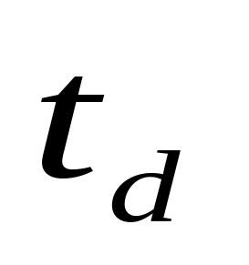
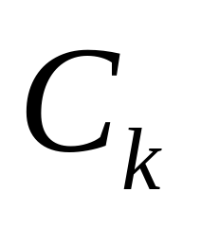
Putnam’s Model
Lines of code: L
Person months: K
Time to develop:
Technology coefficient:

Slide 35
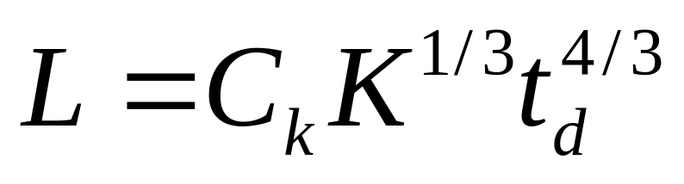
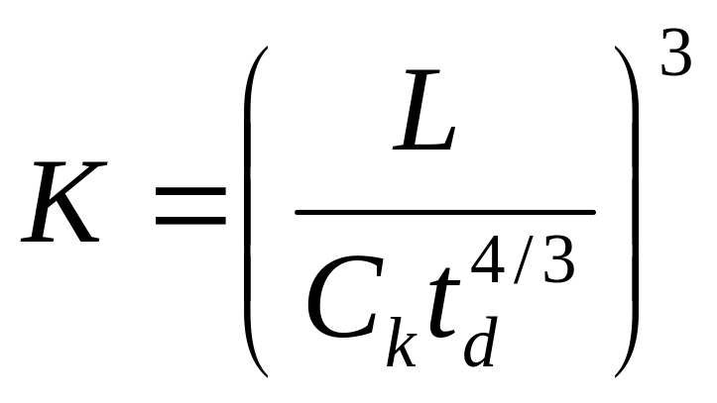
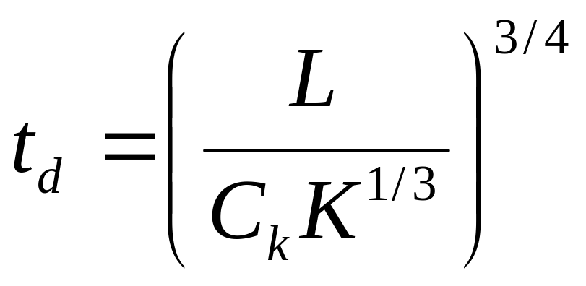
Putnam’s Model
Lines of code:
Person months:
Time to develop:

Slide 36
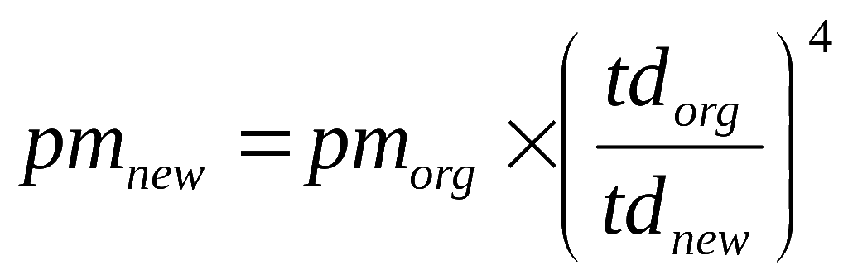
Putnam’s Work
Putnam adapted the Rayleigh-Norden curve:
  Related the number of delivered lines of code to the effort and the time required to develop the product.
  Studied the effect of schedule compression:

Slide 37
Effort Applied vs. Delivery Time
There is a nonlinear relationship between effort applied and delivery time (Putnam-Norden-Rayleigh Curve)‏
  Effort increases rapidly as the delivery time is reduced
Effort
cost
Impossible
region
E _{theoretical}
E _{optimal}
t _{minimum}
t _{theoretical}
t _{optimal}
Development time

Slide 38
Effect of Schedule Change on Cost
Using the Putnam's expression for L,
K=L³/Ck³t_{d}⁴
Or, K=C1/t_{d}⁴
For the same product size, C1=L³/Ck³ is a constant.
Or, K1/K2 = t_{d2}⁴/t_{d1}⁴

Slide 39
Effect of Schedule Change on Cost
Observe:
  A relatively small compression in delivery schedule
    can result in substantial penalty on human effort.
Also, observe:
  benefits can be gained by using fewer people over a somewhat longer time span.

Slide 40
Example
If the estimated development time is 1 year, then in order to develop the product in 6 months,
  the total effort and hence the cost increases 16 times.
  In other words,
    The relationship between effort and the chronological delivery time is highly nonlinear.

Slide 41
Putnam’s Model
Example:
given L=100,000
C1=10,040
t_{d} = 12 ,18, 24months
compute K
t_{d} K
12 988 person-month
18 195 person-month
24 62 person-month

Slide 42
Effect of Schedule Change on Cost
Putnam model indicates extreme penalty for schedule compression
  and extreme reward for expanding the schedule.
Putnam estimation model works reasonably well for very large systems,
  but seriously overestimates the effort for medium and small systems.

